Slide 1
Inheritance
Presentation slides for
Java Software Solutions
Foundations of Program Design
Third Edition
by John Lewis and William Loftus
Java Software Solutions is published by Addison-Wesley
Presentation slides are copyright 200s by John Lewis and William Loftus. All rights reserved.
Instructors using the textbook may use and modify these slides for pedagogical purposes.

Slide 2
Inheritance
Another fundamental object-oriented technique is inheritance, used to organize and create reusable classes
Chapter 7 focuses on:
  deriving new classes from existing classes
  creating class hierarchies
  the protected modifier
  polymorphism via inheritance
  inheritance hierarchies for interfaces
  inheritance used in graphical user interfaces

Slide 3
Inheritance
Inheritance allows a software developer to derive a new class from an existing one
The existing class is called the parent class, or superclass, or base class
The derived class is called the child class or subclass.
As the name implies, the child inherits characteristics of the parent
That is, the child class inherits the methods and data defined for the parent class

Slide 4
Inheritance
To tailor a derived class, the programmer can add new variables or methods, or can modify the inherited ones
Software reuse is at the heart of inheritance
By using existing software components to create new ones, we capitalize on all the effort that went into the design, implementation, and testing of the existing software

Slide 5
Inheritance
Inheritance relationships often are shown graphically in a UML class diagram, with an arrow with an open arrowhead pointing to the parent class
Vehicle
Car
Inheritance should create an is-a relationship, meaning the child is a more specific version of the parent

Slide 6
Deriving Subclasses
In Java, we use the reserved word extends to establish an inheritance relationship
class Car extends Vehicle
{
// class contents
}
See Words.java (page 472)
See Book.java (page 473)
See Dictionary.java (page 474)

Slide 7
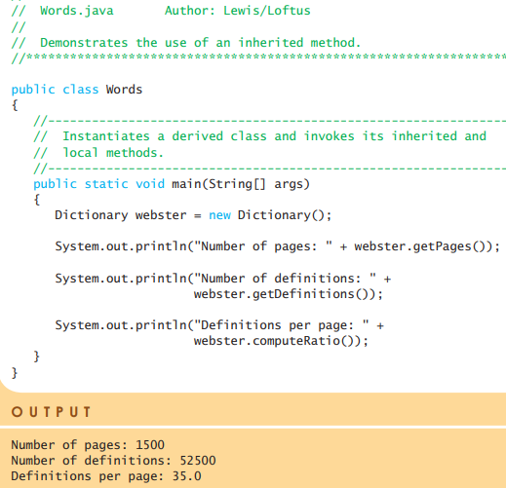
Words.java
In Java, we use the reserved word extends to establish an inheritance relationship
class Car extends Vehicle
{
// class contents
}
See Words.java (page 384)
See Book.java (page 385)
See Dictionary.java (page 386)

Slide 8
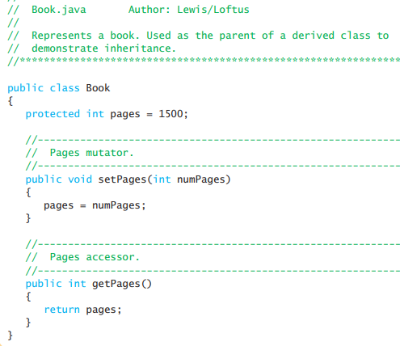
Books.java
In Java, we use the reserved word extends to establish an inheritance relationship
class Car extends Vehicle
{
// class contents
}
See Words.java (page 384)
See Book.java (page 385)
See Dictionary.java (page 386)

Slide 9
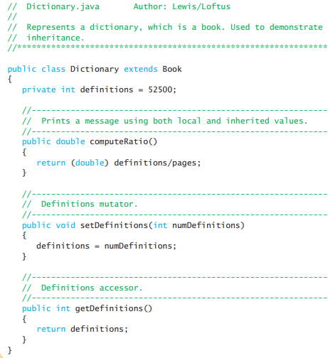
Dictionary.java
In Java, we use the reserved word extends to establish an inheritance relationship
class Car extends Vehicle
{
// class contents
}
See Words.java (page 384)
See Book.java (page 385)
See Dictionary.java (page 386)

Slide 10
The protected Modifier
Visibility modifiers determine which class members are inherited and which are not
Variables and methods declared with public visibility are inherited; those with private visibility are not
But public variables violate the principle of encapsulation
There is a third visibility modifier that helps in inheritance situations: protected

Slide 11
The protected Modifier
The protected modifier allows a member of a base class to be inherited into a child
Protected visibility provides more encapsulation than public visibility does
However, protected visibility is not as tightly encapsulated as private visibility
The details of each modifier are given in Appendix F
Protected variables and methods can be shown with a # symbol preceding them in UML diagrams

Slide 12
UML Diagram for Words
Book
# pages : int
+ pageMessage() : void
Words
Dictionary
- definitions : int
+ main (args : String[]) : void
+ definitionMessage() : void

Slide 13
The super Reference
Constructors are not inherited, even though they have public visibility
Yet we often want to use the parent's constructor to set up the "parent's part" of the object
The super reference can be used to refer to the parent class, and often is used to invoke the parent's constructor
See Words2.java (page 476)
See Book2.java (page 477)
See Dictionary2.java (page 478)

Slide 14
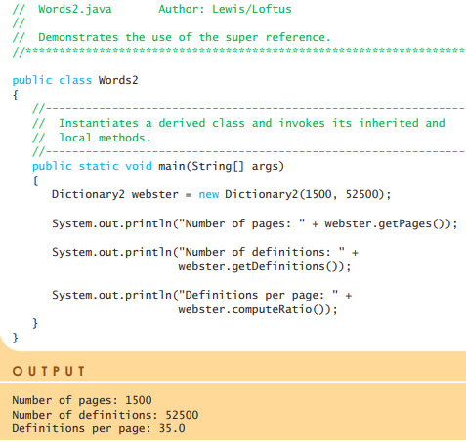
Words2.java
Constructors are not inherited, even though they have public visibility
Yet we often want to use the parent's constructor to set up the "parent's part" of the object
The super reference can be used to refer to the parent class, and often is used to invoke the parent's constructor
See Words2.java (page 388)
See Book2.java (page 389)
See Dictionary2.java (page 390)

Slide 15
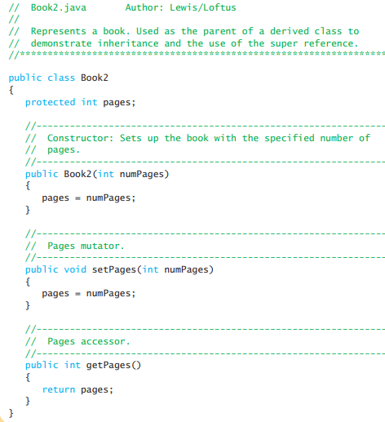
Book2.java
Constructors are not inherited, even though they have public visibility
Yet we often want to use the parent's constructor to set up the "parent's part" of the object
The super reference can be used to refer to the parent class, and often is used to invoke the parent's constructor
See Words2.java (page 388)
See Book2.java (page 389)
See Dictionary2.java (page 390)

Slide 16
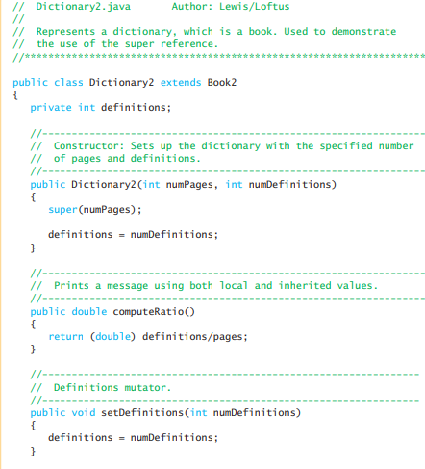

The super Reference
Constructors are not inherited, even though they have public visibility
Yet we often want to use the parent's constructor to set up the "parent's part" of the object
The super reference can be used to refer to the parent class, and often is used to invoke the parent's constructor
See Words2.java (page 388)
See Book2.java (page 389)
See Dictionary2.java (page 390)

Slide 17
The super Reference
A child’s constructor is responsible for calling the parent’s constructor
The first line of a child’s constructor should use the super reference to call the parent’s constructor
The super reference can also be used to reference other variables and methods defined in the parent’s class

Slide 18
Multiple Inheritance
Java supports single inheritance, meaning that a derived class can have only one parent class
Multiple inheritance allows a class to be derived from two or more classes, inheriting the members of all parents
Collisions, such as the same variable name in two parents, have to be resolved
Java does not support multiple inheritance
In most cases, the use of interfaces gives us aspects of multiple inheritance without the overhead

Slide 19
Overriding Methods
A child class can override the definition of an inherited method in favor of its own
The new method must have the same signature as the parent's method, but can have a different body
The type of the object executing the method determines which version of the method is invoked
See Messages.java (page 481)
See Thought.java (page 481)
See Advice.java (page 483)

Slide 20
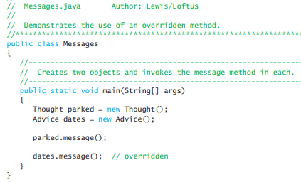

Messages.java
A child class can override the definition of an inherited method in favor of its own
The new method must have the same signature as the parent's method, but can have a different body
The type of the object executing the method determines which version of the method is invoked
See Messages.java (page 481)
See Thought.java (page 393)
See Advice.java (page 394)

Slide 21
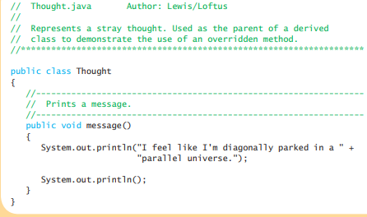
Overriding Methods
A child class can override the definition of an inherited method in favor of its own
The new method must have the same signature as the parent's method, but can have a different body
The type of the object executing the method determines which version of the method is invoked
See Messages.java (page 481)
See Thought.java (page 393)
See Advice.java (page 394)

Slide 22
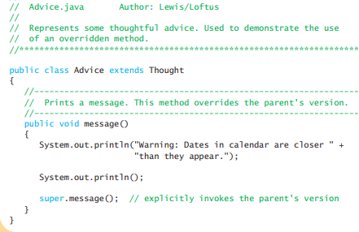
Overriding Methods
A child class can override the definition of an inherited method in favor of its own
The new method must have the same signature as the parent's method, but can have a different body
The type of the object executing the method determines which version of the method is invoked
See Messages.java (page 481)
See Thought.java (page 393)
See Advice.java (page 394)

Slide 23
Overriding
A parent method can be invoked explicitly using the super reference
If a method is declared with the final modifier, it cannot be overridden
The concept of overriding can be applied to data and is called shadowing variables
Shadowing variables should be avoided because it tends to cause unnecessarily confusing code

Slide 24
Overloading vs. Overriding
Don't confuse the concepts of overloading and overriding
Overloading deals with multiple methods with the same name in the same class, but with different signatures
Overriding deals with two methods, one in a parent class and one in a child class, that have the same signature
Overloading lets you define a similar operation in different ways for different data
Overriding lets you define a similar operation in different ways for different object types

Slide 25
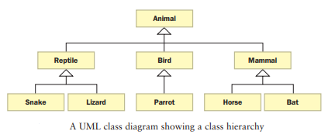
Class Hierarchies
A child class of one parent can be the parent of another child, forming a class hierarchy

Slide 26
Class Hierarchies
Two children of the same parent are called siblings
Common features should be put as high in the hierarchy as is reasonable
An inherited member is passed continually down the line
Therefore, a child class inherits from all its ancestor classes
There is no single class hierarchy that is appropriate for all situations

Slide 27
The Object Class
A class called Object is defined in the java.lang package of the Java standard class library
All classes are derived from the Object class
If a class is not explicitly defined to be the child of an existing class, it is assumed to be the child of the Object class
Therefore, the Object class is the ultimate root of all class hierarchies

Slide 28
The Object Class
The Object class contains a few useful methods, which are inherited by all classes
For example, the toString method is defined in the Object class
Every time we have defined toString, we have actually been overriding an existing definition
The toString method in the Object class is defined to return a string that contains the name of the object’s class together along with some other information

Slide 29
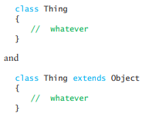
The Object Class

Slide 30
The Object Class
All objects are guaranteed to have a toString method via inheritance
Thus the println method can call toString for any object that is passed to it
See Academia.java (page 398)
See Student.java (page 399)
See GradStudent.java (page 400)

Slide 31
The Object Class
The equals method of the Object class returns true if two references are aliases
We can override equals in any class to define equality in some more appropriate way
The String class (as we've seen) defines the equals method to return true if two String objects contain the same characters
Therefore the String class has overridden the equals method inherited from Object in favor of its own version

Slide 32
Abstract Classes
An abstract class is a placeholder in a class hierarchy that represents a generic concept
An abstract class cannot be instantiated
We use the modifier abstract on the class header to declare a class as abstract:
public abstract class Whatever
{
// contents
}

Slide 33
Abstract Classes
An abstract class often contains abstract methods with no definitions (like an interface does)
Unlike an interface, the abstract modifier must be applied to each abstract method
An abstract class typically contains non-abstract methods (with bodies), further distinguishing abstract classes from interfaces
A class declared as abstract does not need to contain abstract methods

Slide 34
Abstract Classes
The child of an abstract class must override the abstract methods of the parent, or it too will be considered abstract
An abstract method cannot be defined as final (because it must be overridden) or static (because it has no definition yet)
The use of abstract classes is a design decision – it helps us establish common elements in a class that is too general to instantiate

Slide 35
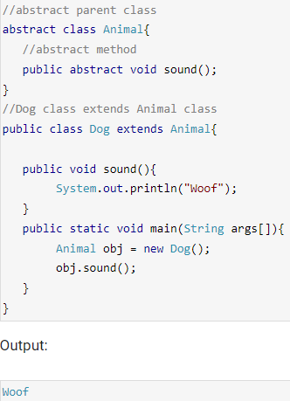
Abstract Classes

Slide 36
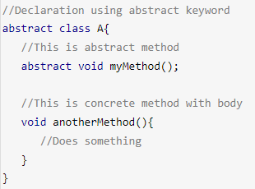
Abstract Classes
The child of an abstract

Slide 37
Abstract Classes Rules
A class derived from the abstract class must implement all those methods that are declared as abstract in the parent class.
Abstract class cannot be instantiated which means you cannot create the object of it. To use this class, you need to create another class that extends this this class and provides the implementation of abstract methods, then you can use the object of that child class to call non-abstract methods of parent class as well as implemented.
If a child does not implement all the abstract methods of abstract parent class, then the child class must need to be declared abstract as well.

Slide 38
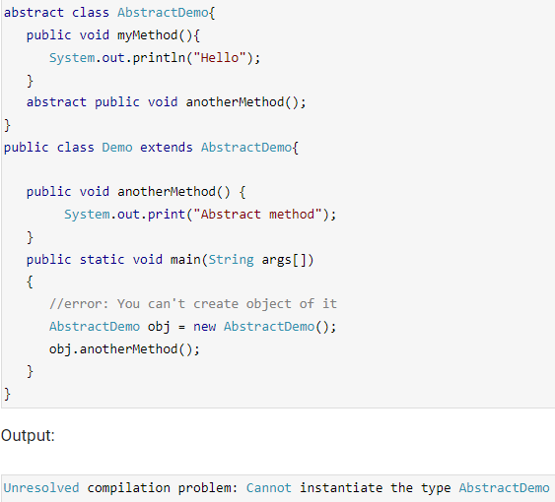
Abstract Classes Error

Slide 39
Abstract vs Concrete class
A class which is not abstract is referred as Concrete class.
In the above example that we have seen in the beginning of this guide, Animal is a abstract class and Cat, Dog & Lion are concrete classes.

Slide 40
Abstract Classes Rules
A class derived from the abstract class must implement all those methods that are declared as abstract in the parent class.
Abstract class cannot be instantiated which means you cannot create the object of it. To use this class, you need to create another class that extends this this class and provides the implementation of abstract methods, then you can use the object of that child class to call non-abstract methods of parent class as well as implemented.
If a child does not implement all the abstract methods of abstract parent class, then the child class must need to be declared abstract as well.

Slide 41
Indirect Use of Members
An inherited member can be referenced directly by name in the child class, as if it were declared in the child class
But even if a method or variable is not inherited by a child, it can still be accessed indirectly through parent methods
See FoodAnalyzer.java (page 489)
See FoodItem.java (page 490)
See Pizza.java (page 491)

Slide 42

Food Analyzer.java
An inherited member can be referenced directly by name in the child class, as if it were declared in the child class
But even if a method or variable is not inherited by a child, it can still be accessed indirectly through parent methods
See FoodAnalysis.java (page 403)
See FoodItem.java (page 404)
See Pizza.java (page 405)

Slide 43
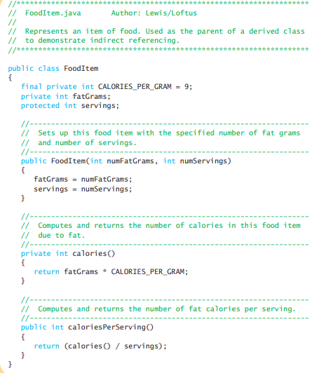
FoodItem.java
An inherited member can be referenced directly by name in the child class, as if it were declared in the child class
But even if a method or variable is not inherited by a child, it can still be accessed indirectly through parent methods
See FoodAnalysis.java (page 403)
See FoodItem.java (page 404)
See Pizza.java (page 405)

Slide 44
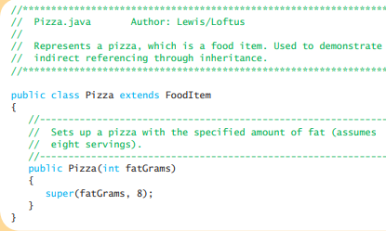
Pizza.java
An inherited member can be referenced directly by name in the child class, as if it were declared in the child class
But even if a method or variable is not inherited by a child, it can still be accessed indirectly through parent methods
See FoodAnalysis.java (page 403)
See FoodItem.java (page 404)
See Pizza.java (page 405)

Slide 45
Polymorphism
A reference can be polymorphic, which can be defined as "having many forms"
obj.doIt();
This line of code might execute different methods at different times if the object that obj points to changes
Polymorphic references are resolved at run time; this is called dynamic binding
Careful use of polymorphic references can lead to elegant, robust software designs
Polymorphism can be accomplished using inheritance or using interfaces

Slide 46
References and Inheritance
An object reference can refer to an object of its class, or to an object of any class related to it by inheritance
For example, if the Holiday class is used to derive a child class called Christmas, then a Holiday reference could be used to point to a Christmas object
Holiday
Holiday day;
day = new Christmas();
Christmas

Slide 47
References and Inheritance
Assigning a predecessor object to an ancestor reference is considered to be a widening conversion, and can be performed by simple assignment
Assigning an ancestor object to a predecessor reference can be done also, but it is considered to be a narrowing conversion and must be done with a cast
The widening conversion is the most useful
An Object reference can be used to refer to any object
  An ArrayList is designed to hold Object references

Slide 48
Polymorphism via Inheritance
It is the type of the object being referenced, not the reference type, that determines which method is invoked
Suppose the Holiday class has a method called celebrate, and the Christmas class overrides it
Now consider the following invocation:
day.celebrate();
If day refers to a Holiday object, it invokes the Holiday version of celebrate; if it refers to a Christmas object, it invokes the Christmas version

Slide 49
Polymorphism via Inheritance
Consider the following class hierarchy:
StaffMember
Volunteer
Employee
Executive
Hourly

Slide 50
Polymorphism via Inheritance
Now consider the task of paying all employees
See Firm.java (page 410)
See Staff.java (page 412)
See StaffMember.java (page 414)
See Volunteer.java (page 415)
See Employee.java (page 416)
See Executive.java (page 417)
See Hourly.java (page 418)

Slide 51
Interface Hierarchies
Inheritance can be applied to interfaces as well as classes
One interface can be derived from another interface
The child interface inherits all abstract methods of the parent
A class implementing the child interface must define all methods from both the ancestor and child interfaces
All members of an interface are public
Note that class hierarchies and interface hierarchies are distinct (they do not overlap)

Slide 52
Polymorphism via Interfaces
An interface name can be used as the type of an object reference variable
Doable obj;
The obj reference can be used to point to any object of any class that implements the Doable interface
The version of doThis that the following line invokes depends on the type of object that obj is referencing
obj.doThis();

Slide 53
Inheritance and GUIs
An applet is an excellent example of inheritance
Recall that when we define an applet, we extend the Applet class or the JApplet class
The Applet and JApplet classes already handle all the details about applet creation and execution, including:
  interaction with a Web browser
  accepting applet parameters through HTML
  enforcing security restrictions

Slide 54
Inheritance and GUIs
Our applet classes only have to deal with issues that specifically relate to what our particular applet will do
When we define the paint method of an applet, for instance, we are actually overriding a method defined in the Component class, which is ultimately inherited into the Applet or JApplet class

Slide 55
The Component Class Hierarchy
The Java classes that define GUI components are part of a class hierarchy
Swing GUI components typically are derived from the JComponent class which is derived from the Container class which is derived from the Component class
Many Swing components can serve as (limited) containers, because they are derived from the Container class

Slide 56
Mouse Events
Events related to the mouse are separated into mouse events and mouse motion events
Mouse Events:
  mouse pressed – the mouse button is pressed down
  mouse released – the mouse button is released
  mouse clicked – the mouse button is pressed down and released without moving the mouse in between
  mouse entered – the mouse pointer is moved onto (over) a component
  mouse exited – the mouse pointer is moved off of a component

Slide 57
Mouse Events
Mouse Motion Events:
  mouse moved – the mouse is moved
  mouse dragged – the mouse is dragged
To satisfy the implementation of a listener interface, empty methods must be provided for unused events
An ArrayList object is used to store objects so they can be redrawn as necessary
See Dots.java (page 427)
See DotsPanel.java (page 428)

Slide 58
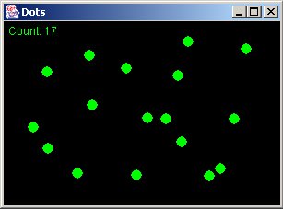
The Dots Program

Slide 59
Mouse Events
Each time the repaint method is called on an applet, the window is cleared prior to calling paint
Rubberbanding is the visual effect caused by "stretching" a shape as it is drawn using the mouse
See RubberLines.java (page 431)
See RubberLinesPanel.java (page 432)

Slide 60
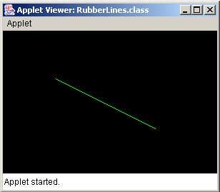
The RubberLines Program

Slide 61
Event Adapter Classes
Listener classes can be created by implementing a particular interface (such as MouseListener interface)
A listener also can be created by extending an event adapter class
Each listener interface has a corresponding adapter class (such as the MouseAdapter class)
Each adapter class implements the corresponding listener and provides empty method definitions

Slide 62
Event Adapter Classes
When we derive a listener class from an adapter class, we override any event methods of interest (such as the mouseClicked method)
Empty definitions for unused event methods need not be provided
See OffCenter.java (page 435)
See OffCenterPanel.java (page 437)

Slide 63
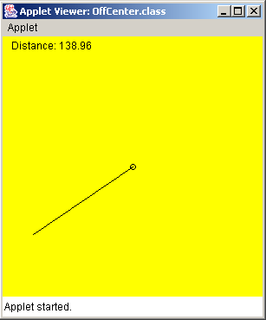
The OffCenter Program

Slide 64
Summary
Chapter 7 has focused on:
  deriving new classes from existing classes
  creating class hierarchies
  the protected modifier
  polymorphism via inheritance
  inheritance hierarchies for interfaces
  inheritance used in graphical user interfaces

